Slide 1

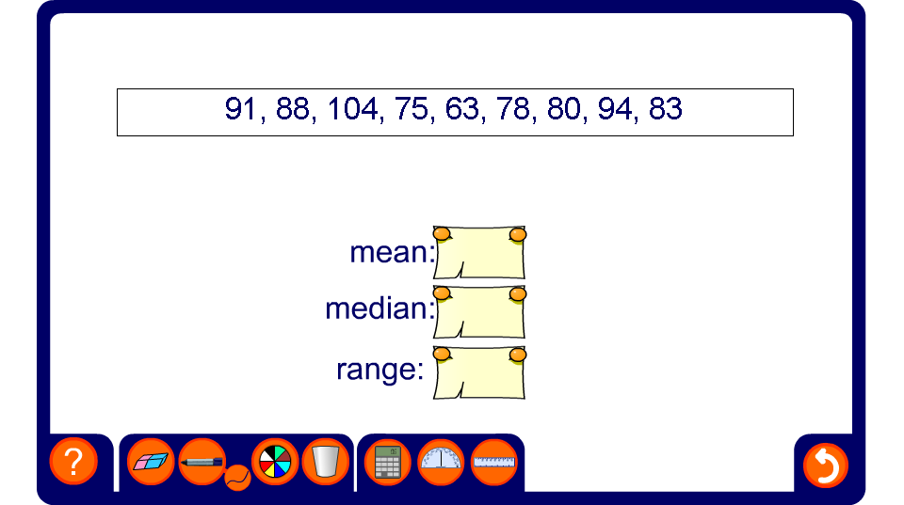


Calculating the mean, median and range
Notes:
Each time the activity is reset a new set of data is generated. Calculate the mean, median and range. This could be done as a competition in teams or with mini whiteboards.
If required, ask a volunteer to come to the board and use the pen tool to write the given data set in order first.

